Slide 1
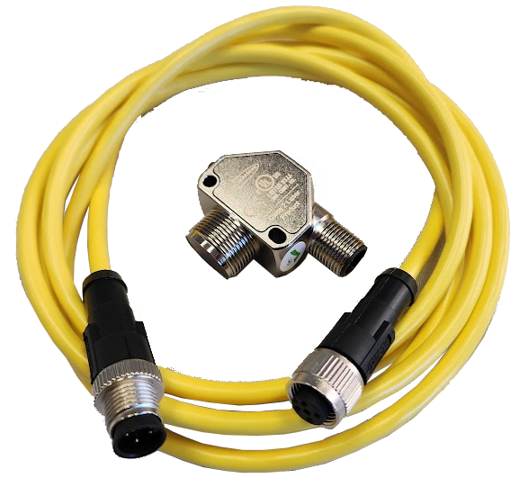
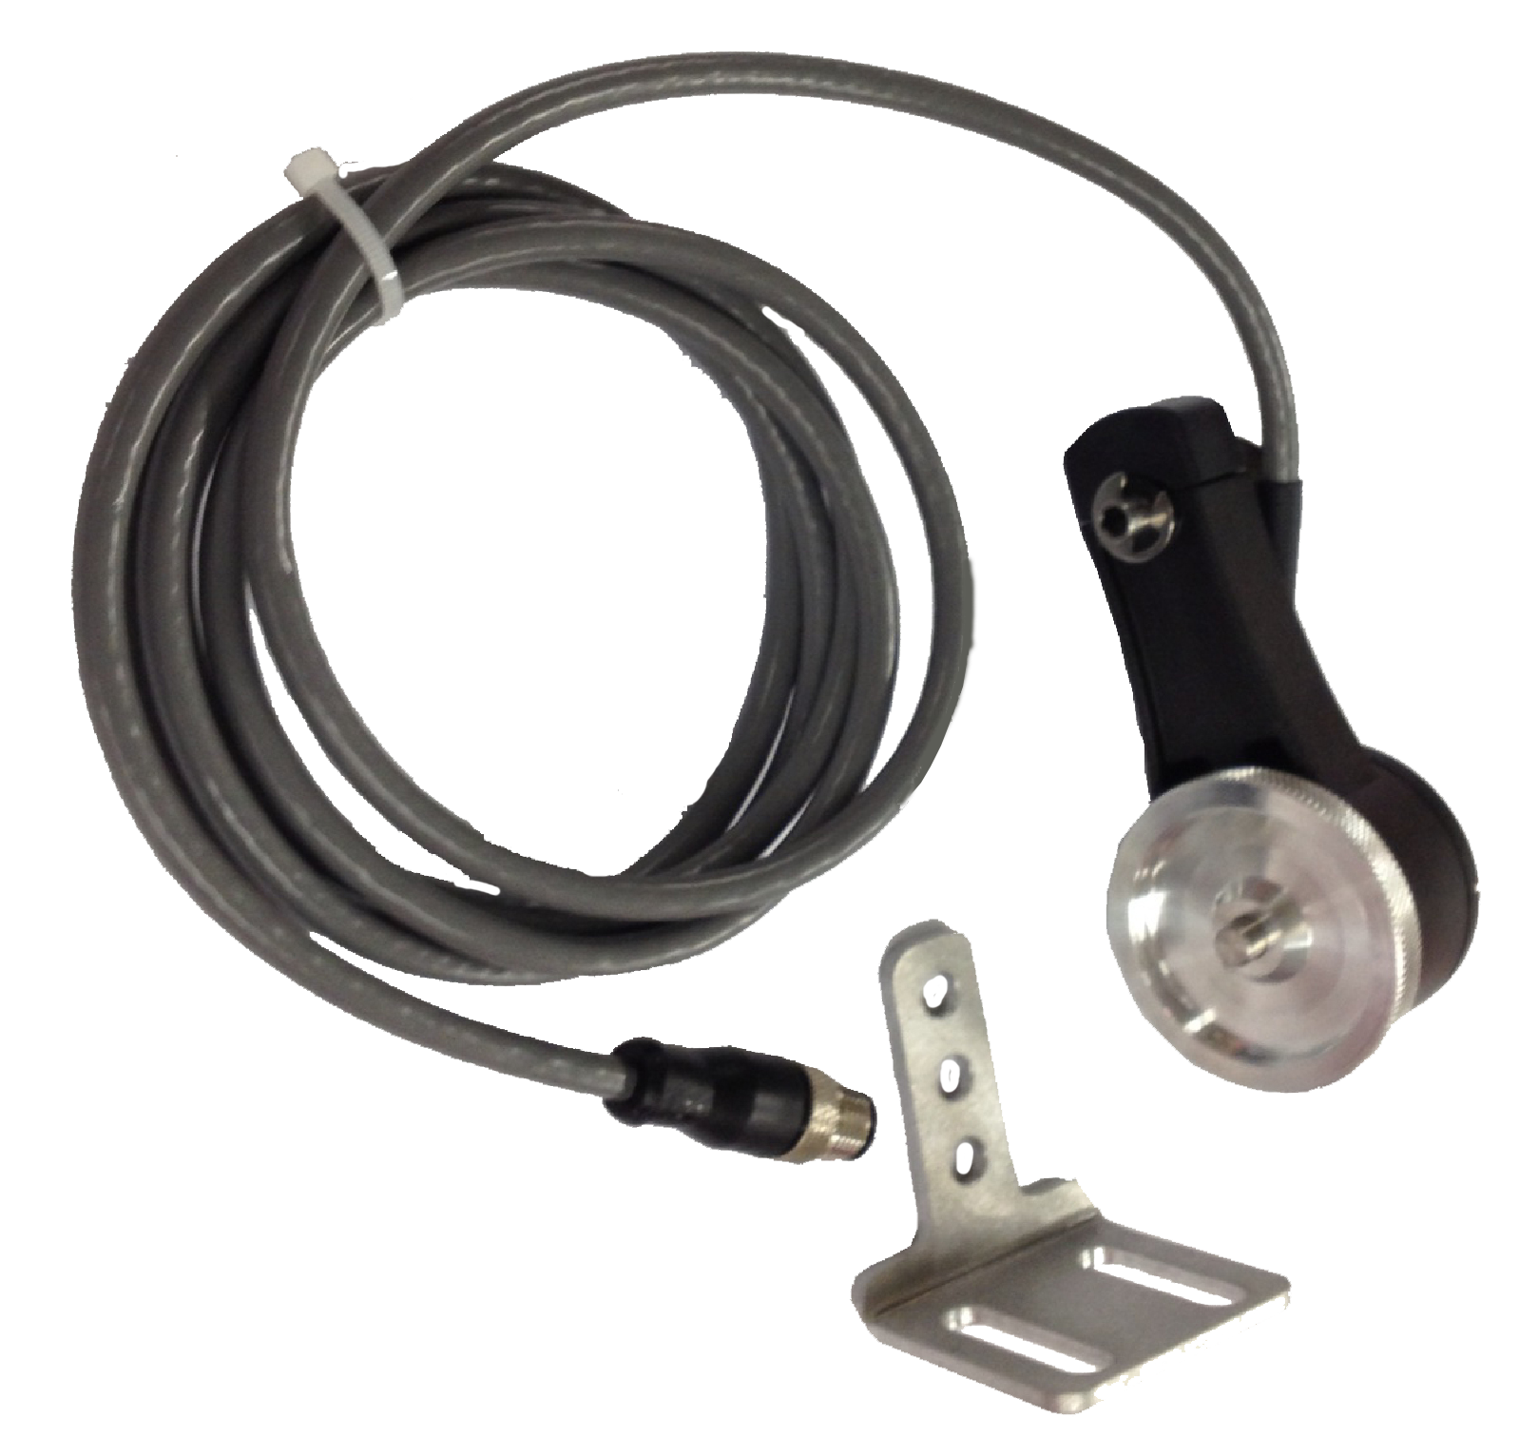
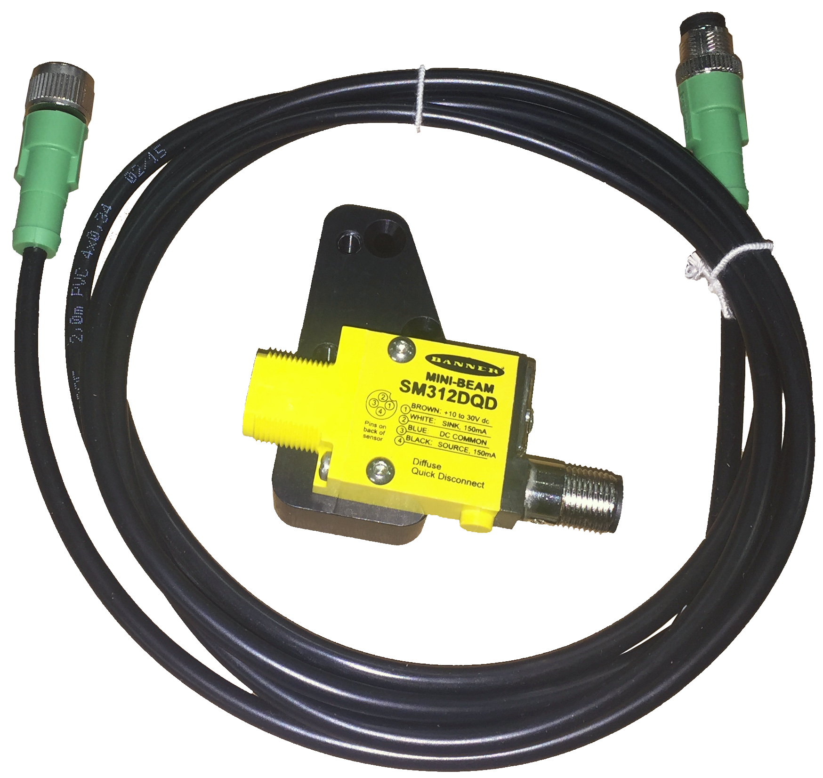
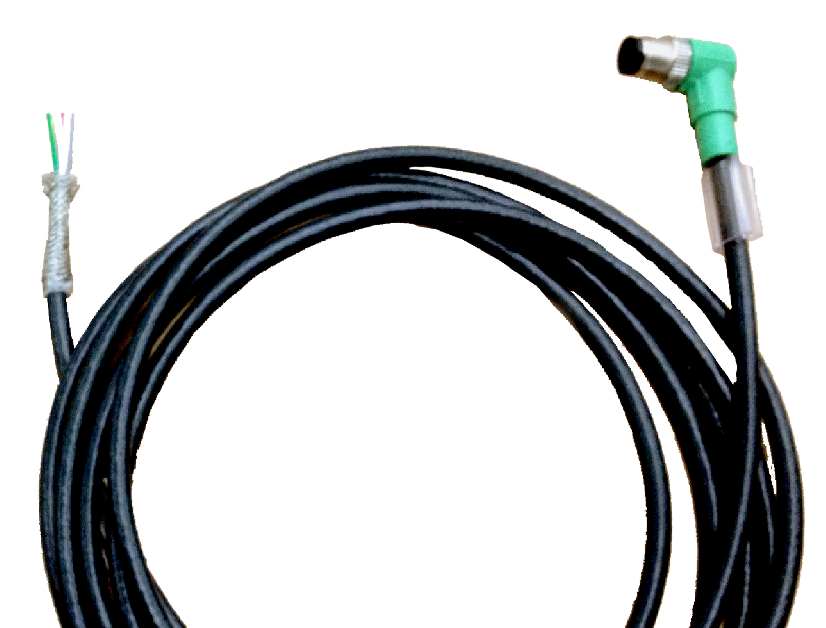
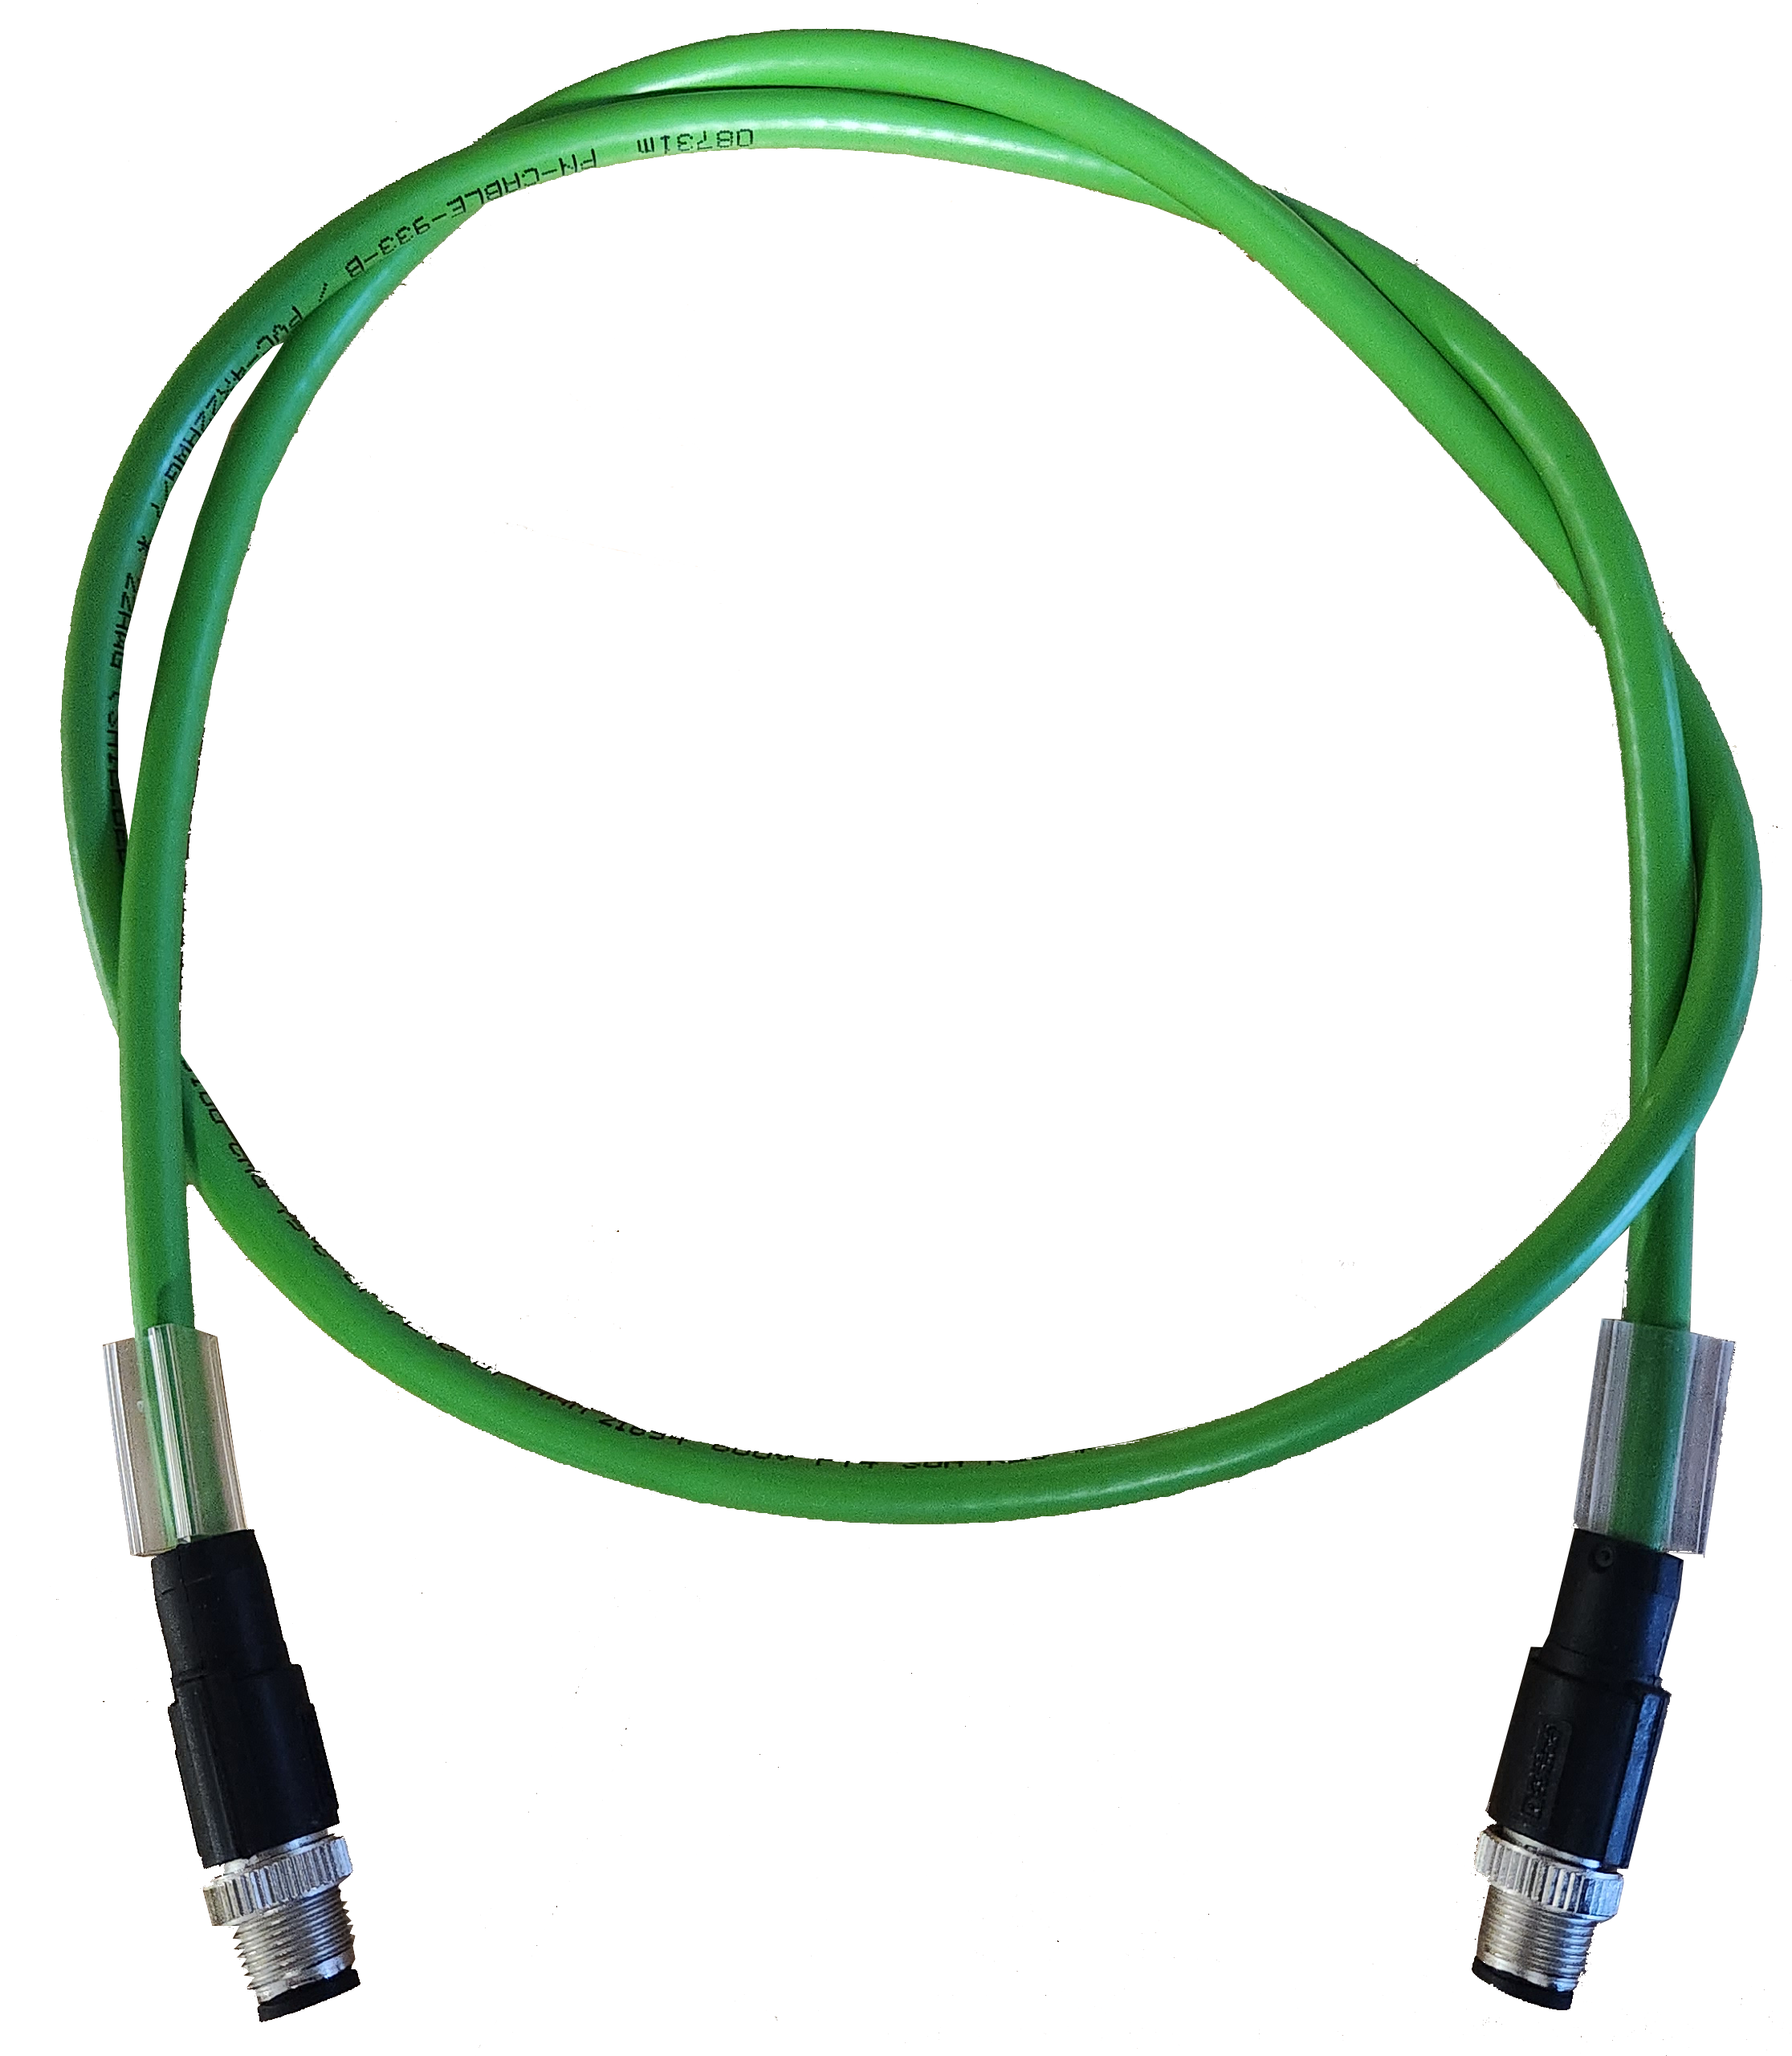
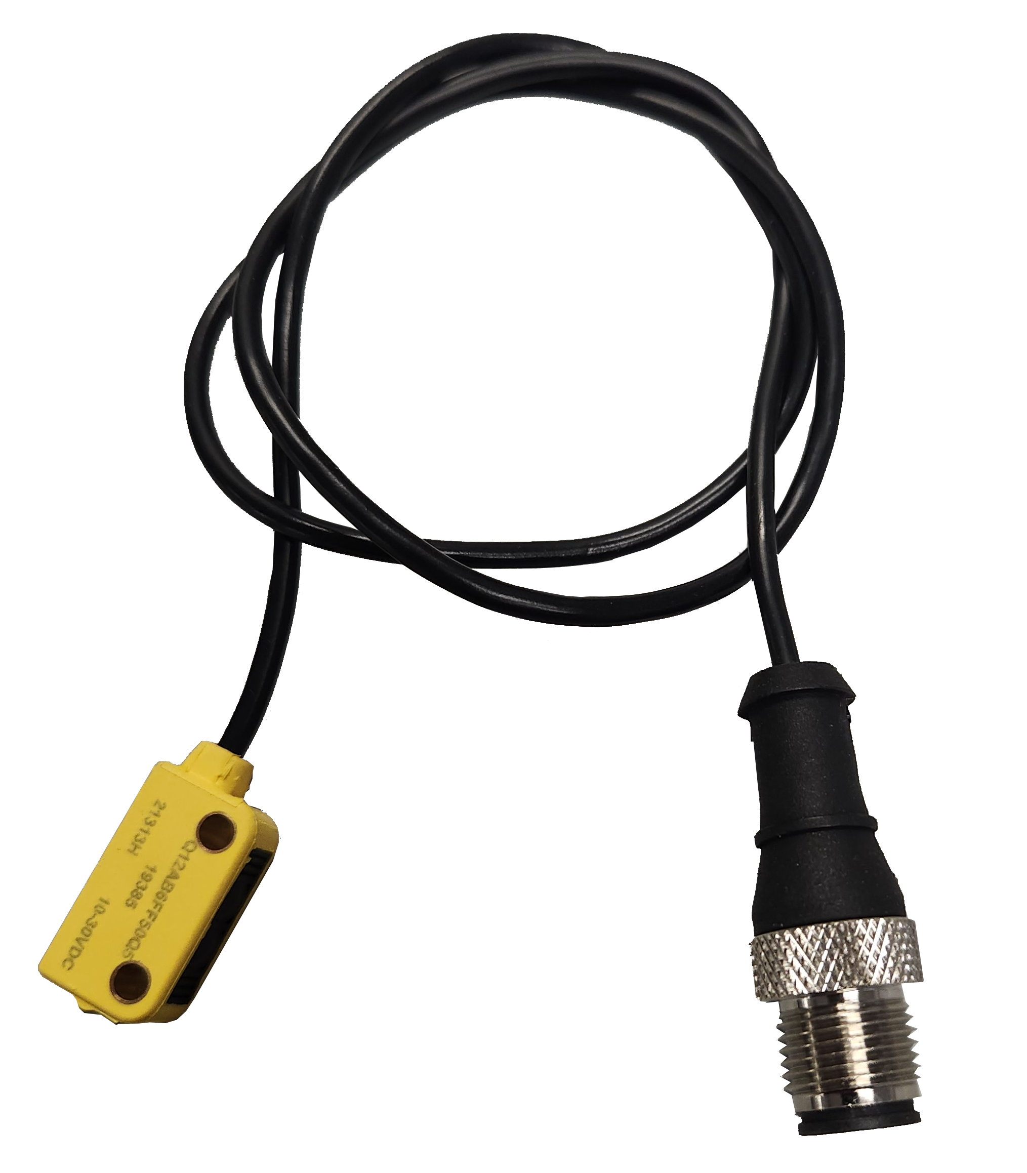


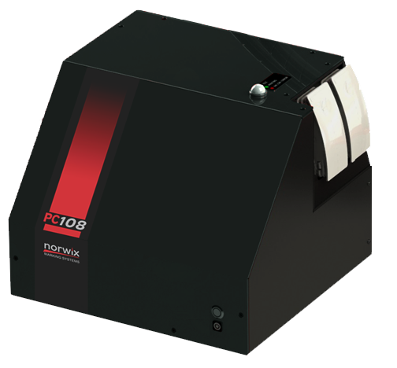
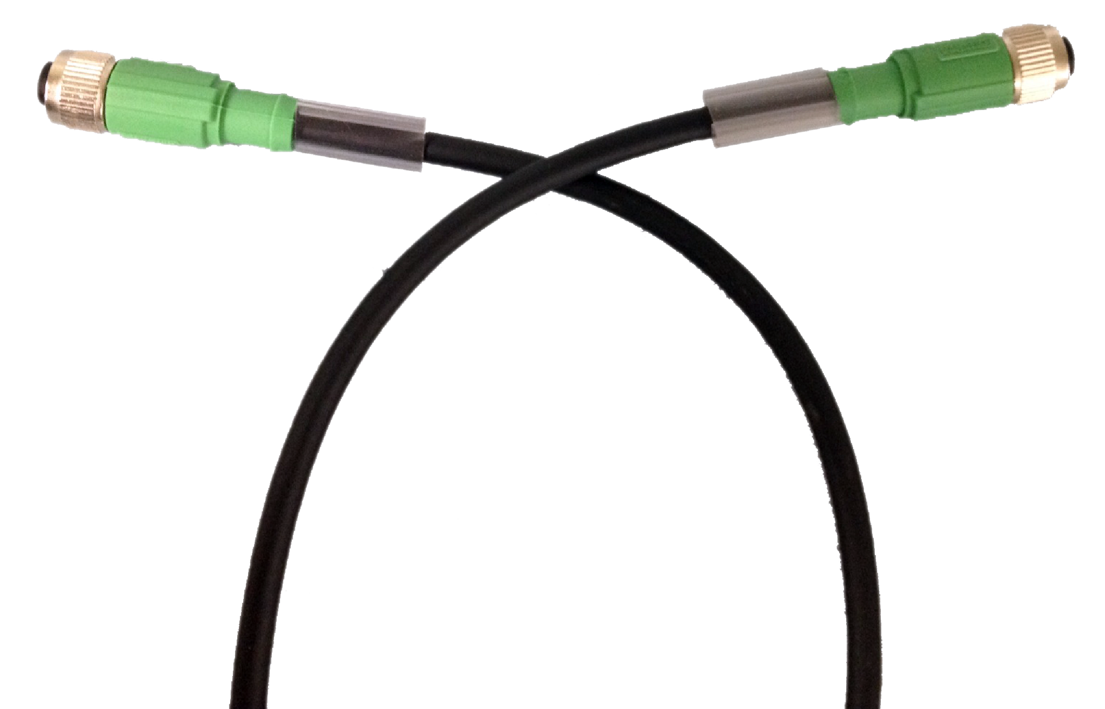
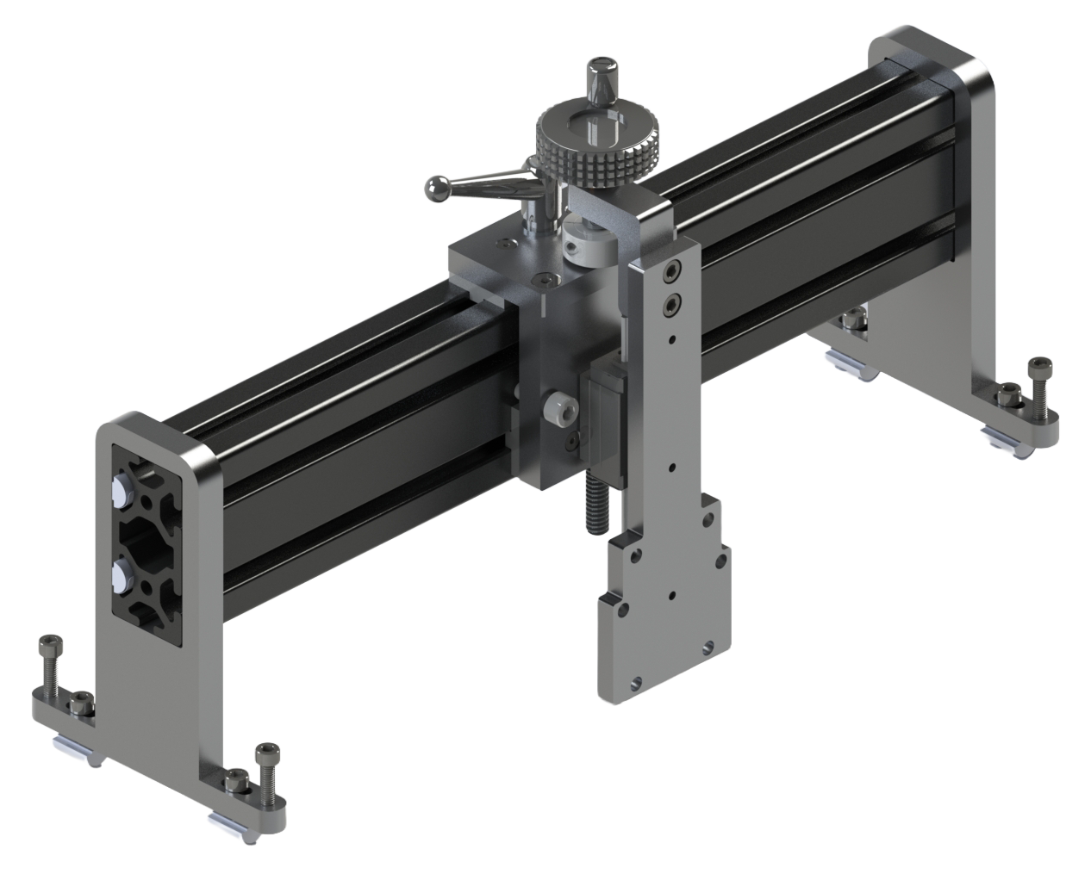
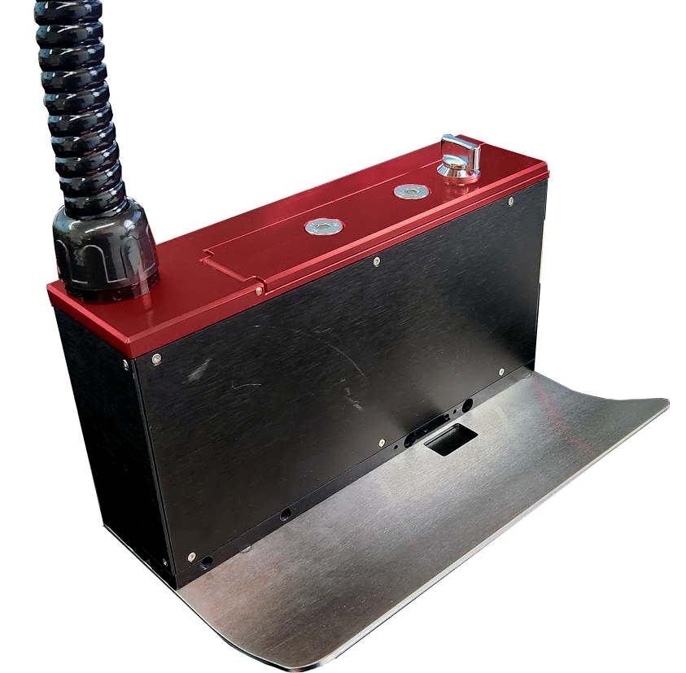
PC108 Catalog 2025
Encoder Kits
5019671G (Knurled Wheel)
5020082G (Urethane Wheel)
Sensor Kit
5019667G
Laser Sensor Kit
5020159G
Sensor kit
Supplied with 2m cable and mounting
Resolution of 1800 pulses/rev
2m cable length
6” circumference wheel
I/O Cable Assembly
4971170G
High-accuracy laser sensor
2m cable
Connection to stack light connection on UNO Plus
5 m length
Custom lengths available
Daisy Chain Cable
4970905G-0300
Mini Sensor
4093075G
3m Length
Connects to Daisy In/Daisy out on Print Controller
Label sensor
Needs additional Sensor Cable (4971005G)
1 to 2 heads
Sensor Interface Cable
4971005G
Suitable for sensor other than Norwix supplied
Required for Label Sensor
2 m length
PC108 Print Controller 5020323G
Supports 2 x 108mm printheads
Dual 775ml Bulk
Daisy Chain capable
HP108 Head Mount
5020247G
Mounts Print head
Allows for 90-degree mounting
Adjustable horizontal and vertical locking handles
Infeed Ski Kit
5020317G (1 Print Stall)
5020318G (2 Print Stall)
HP108 Mount Bar
50120321G
HP108 Mount (Vertical)
5020322G
HP108 Print Stall 5020220G
Mounts Print head
Allows for 90-degree mounting
Adjustable horizontal and vertical locking handles
108mm print width
2.8m Umbilical
Supplied with Head Clip
Affixes directly to print head
Each Kit comes with both Left and Right Skis
Mounting points for Mini Sensor (4093075G)
Designed for PC108 Mount and curing head mount
25.5” 80/20 aluminum bar (40mmx80mm

