Slide 1
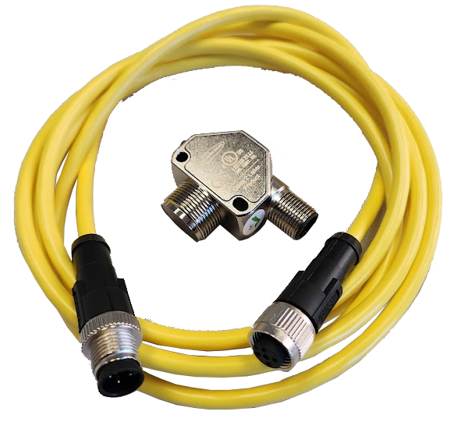
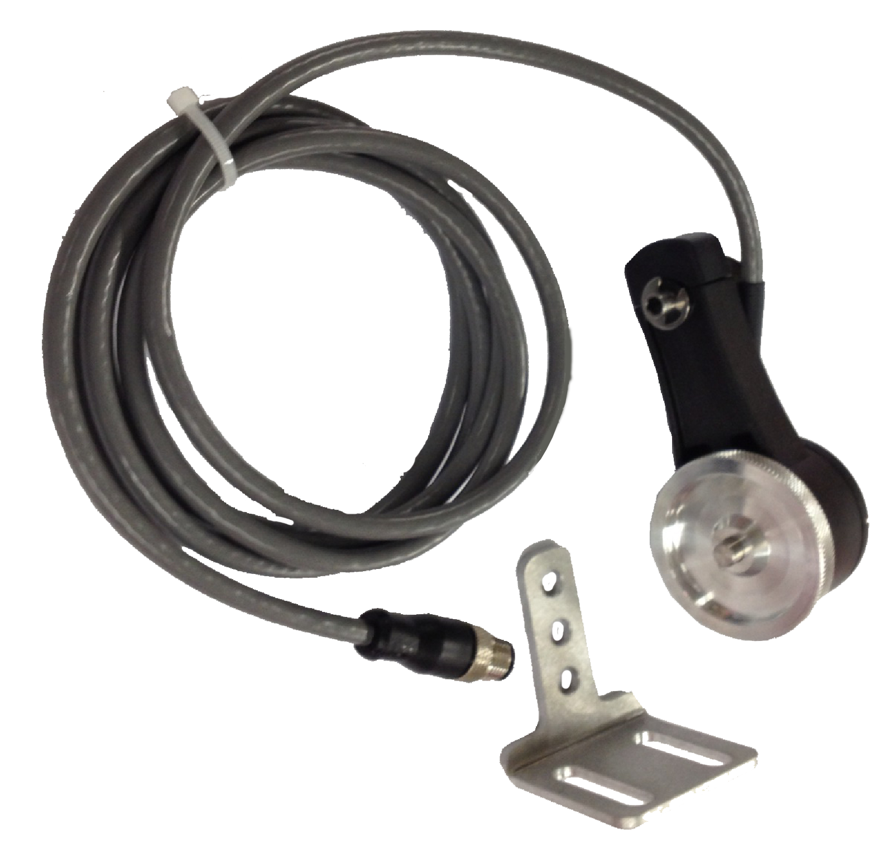
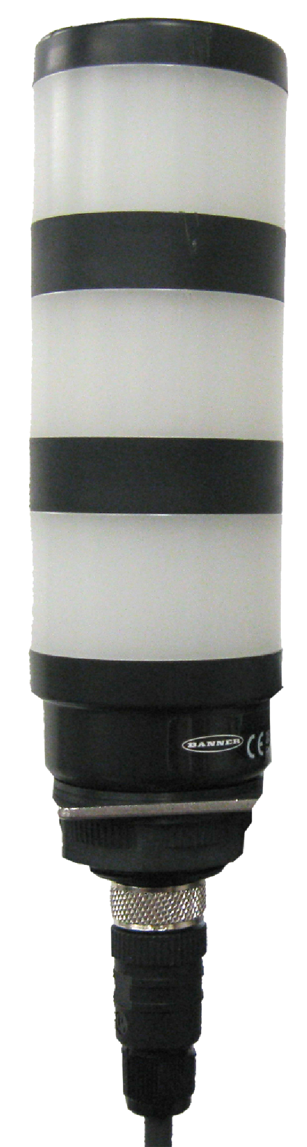
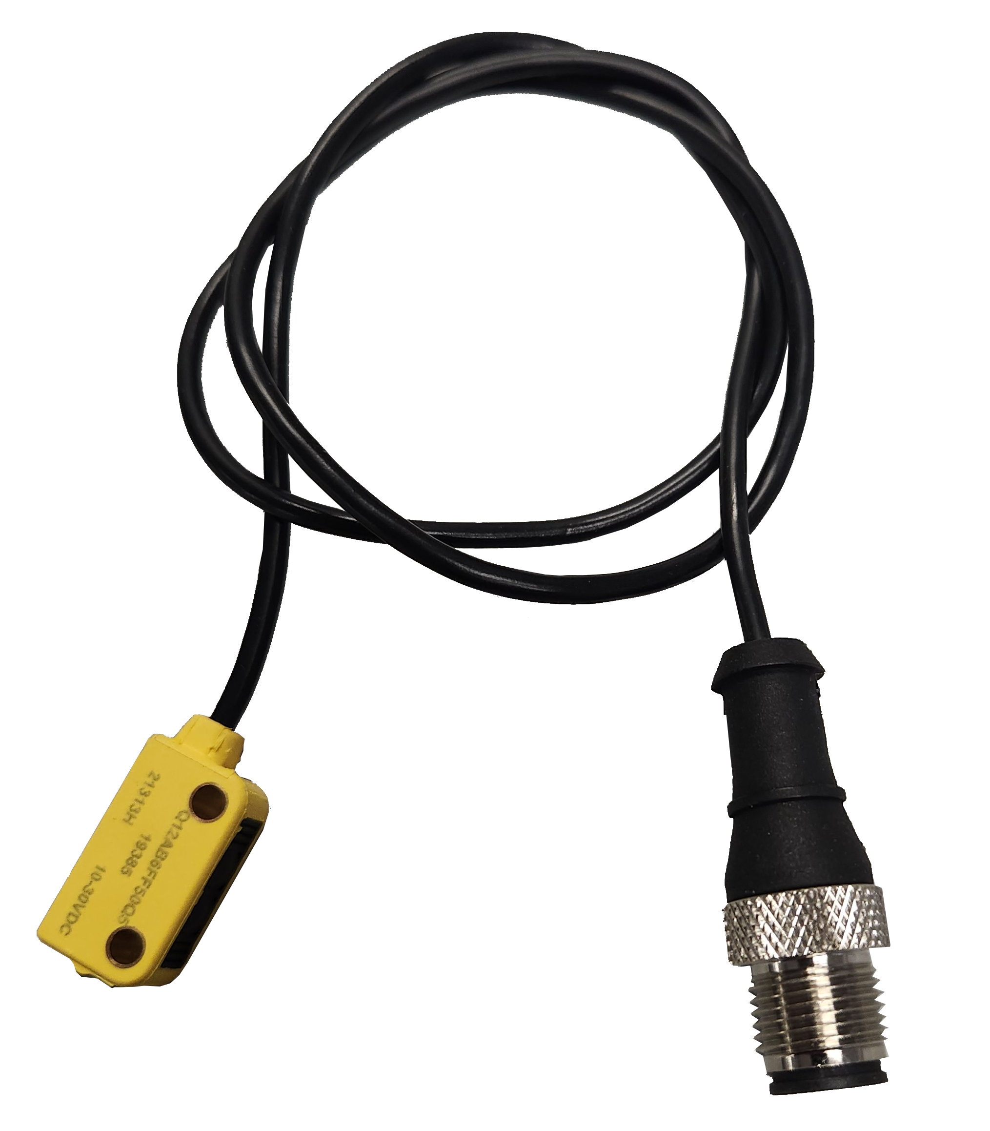
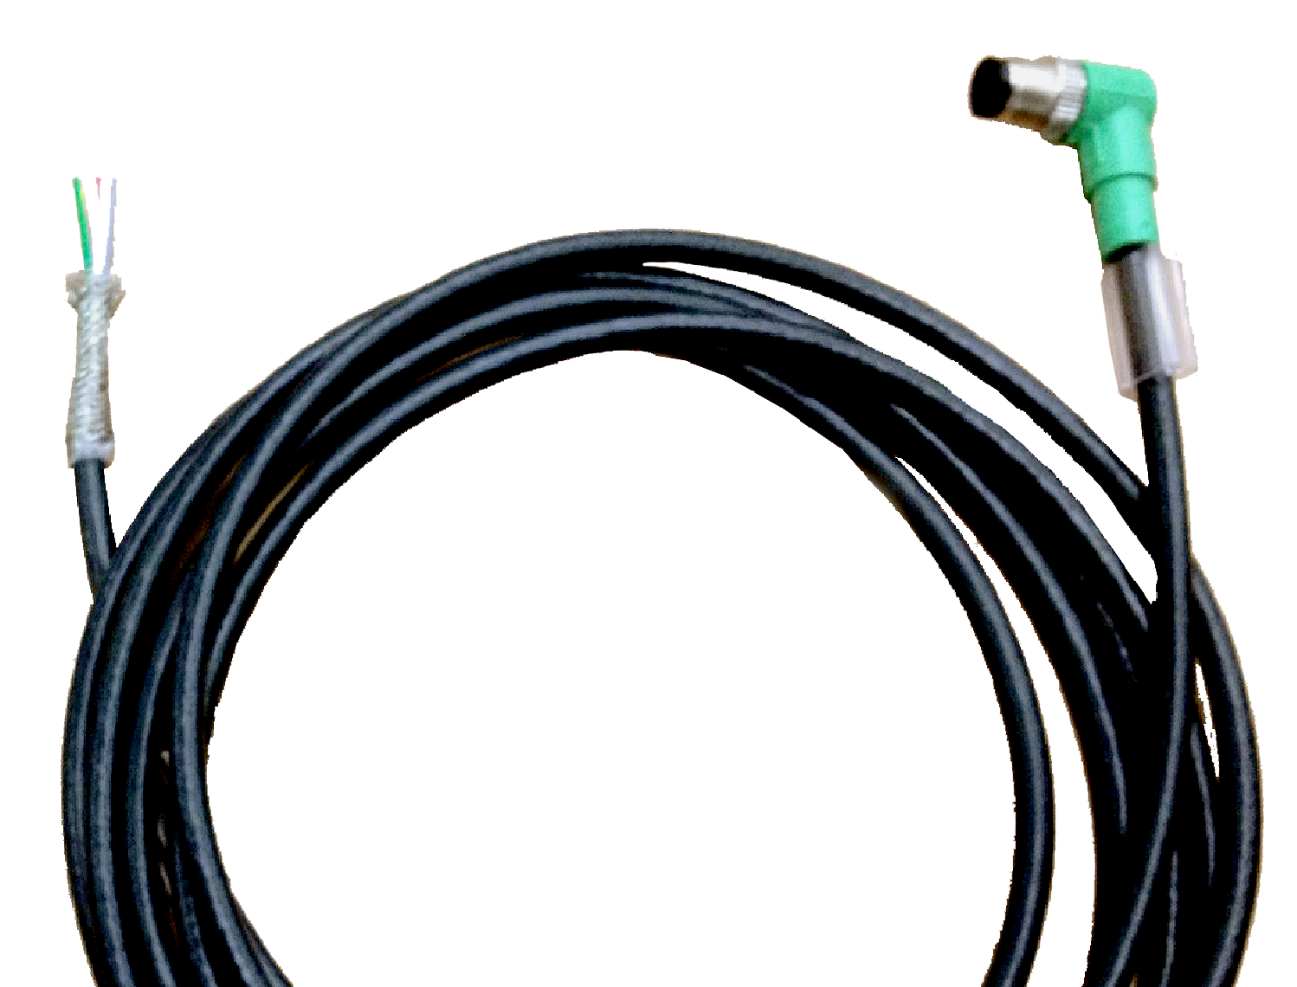
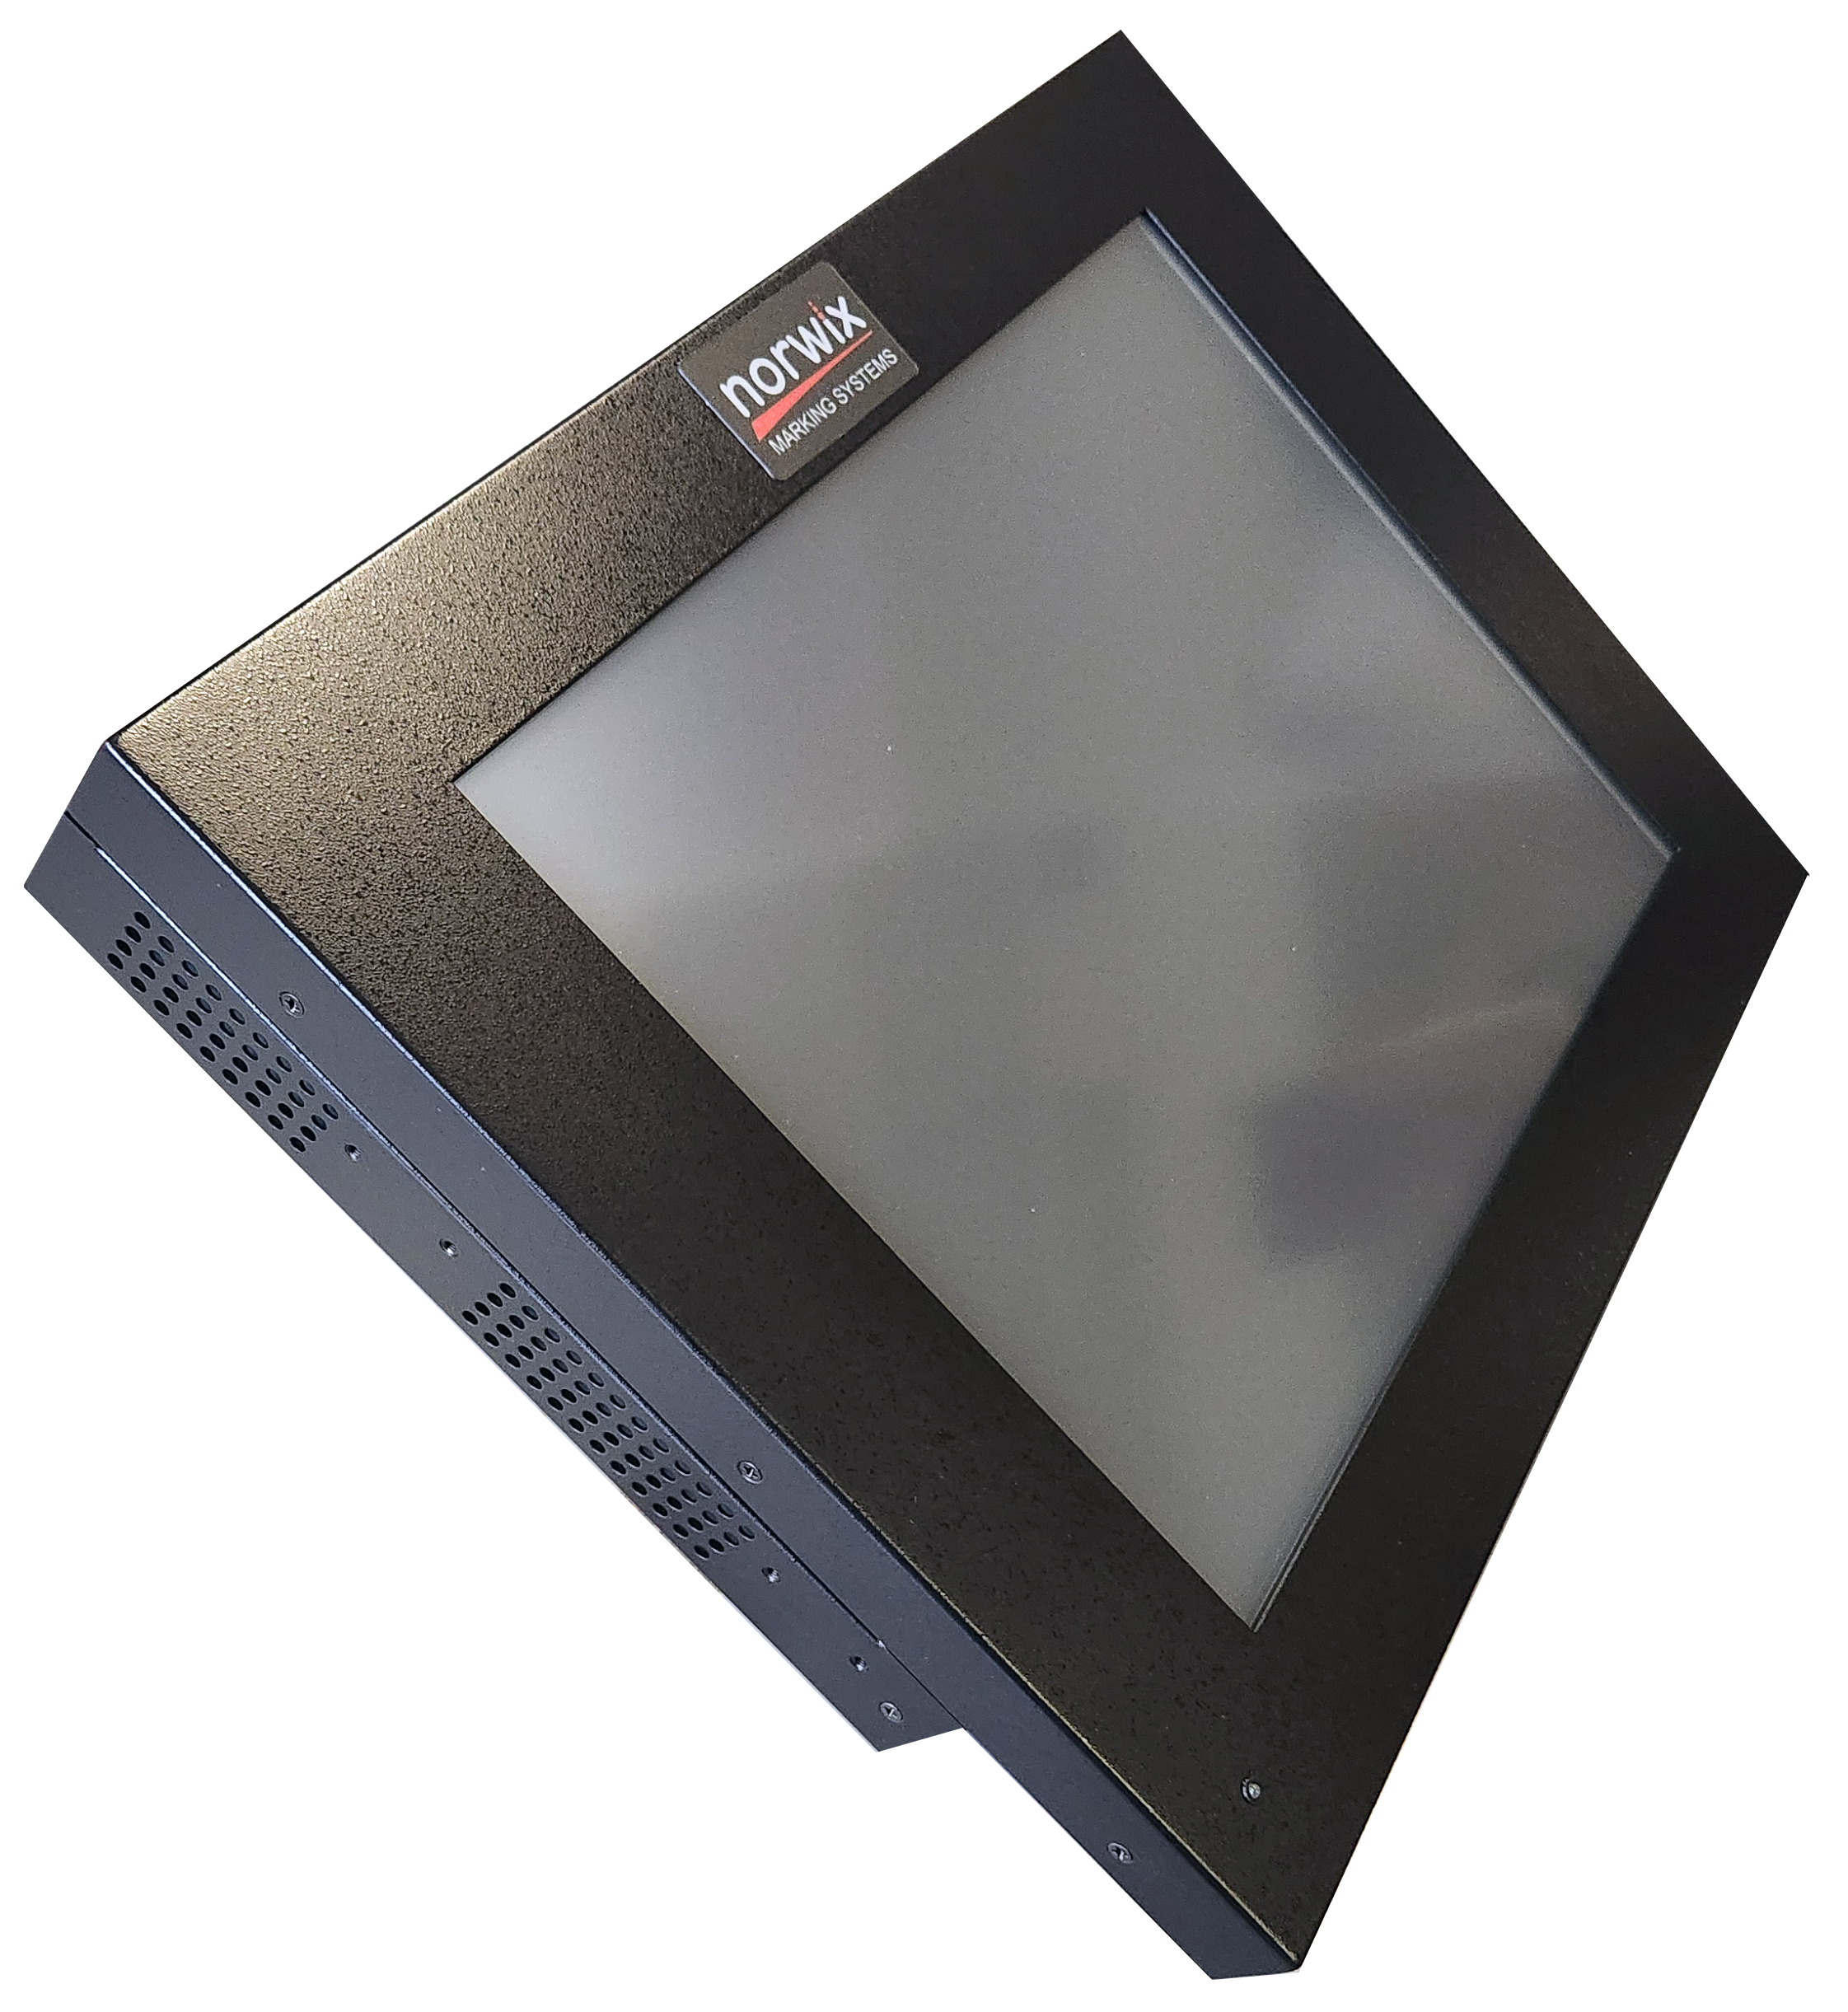

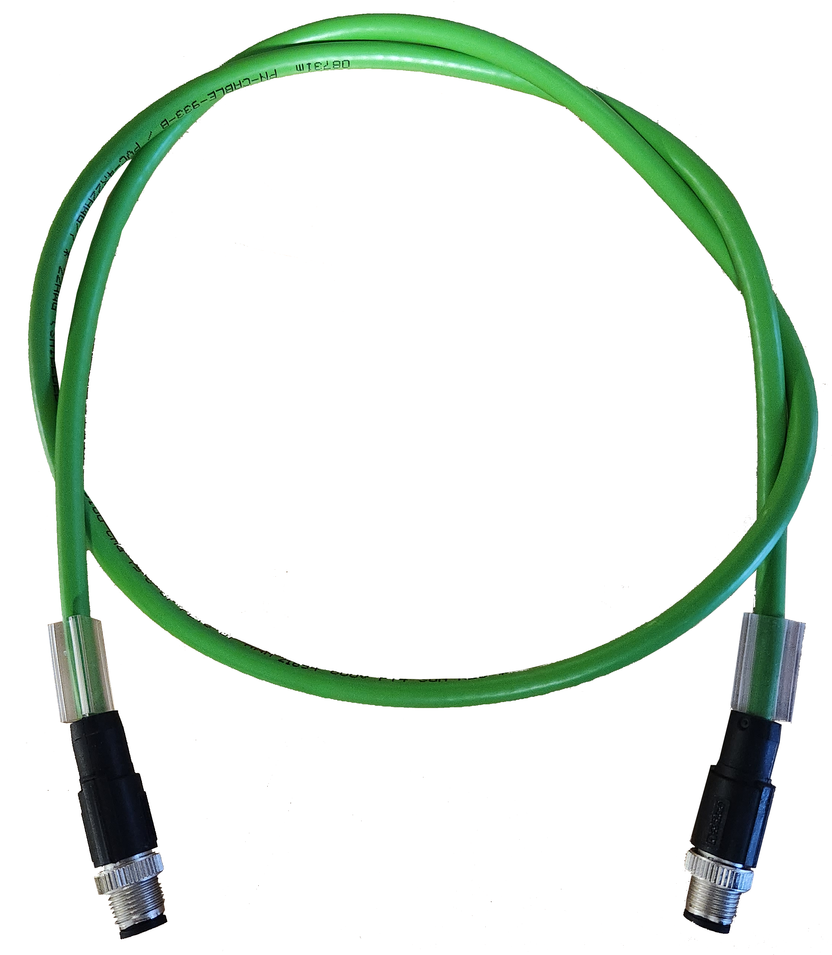
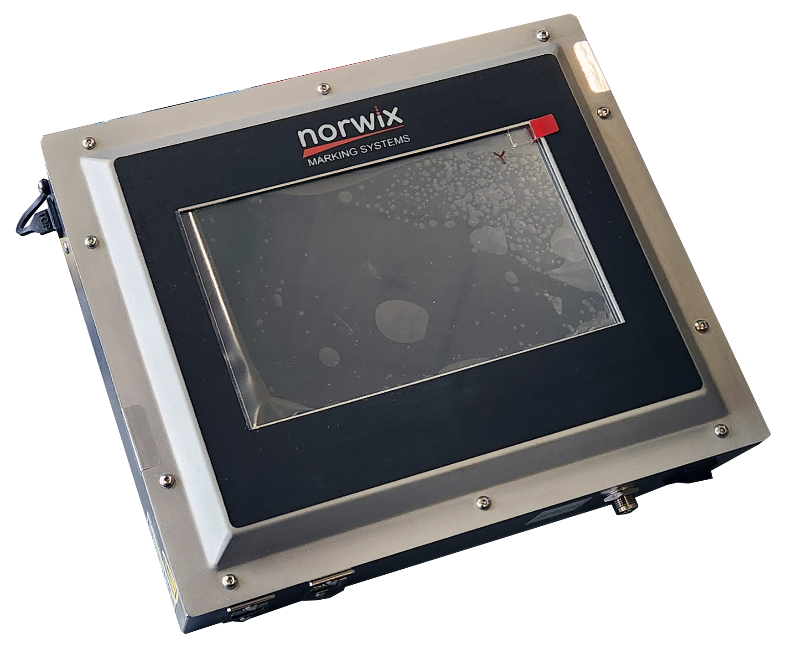

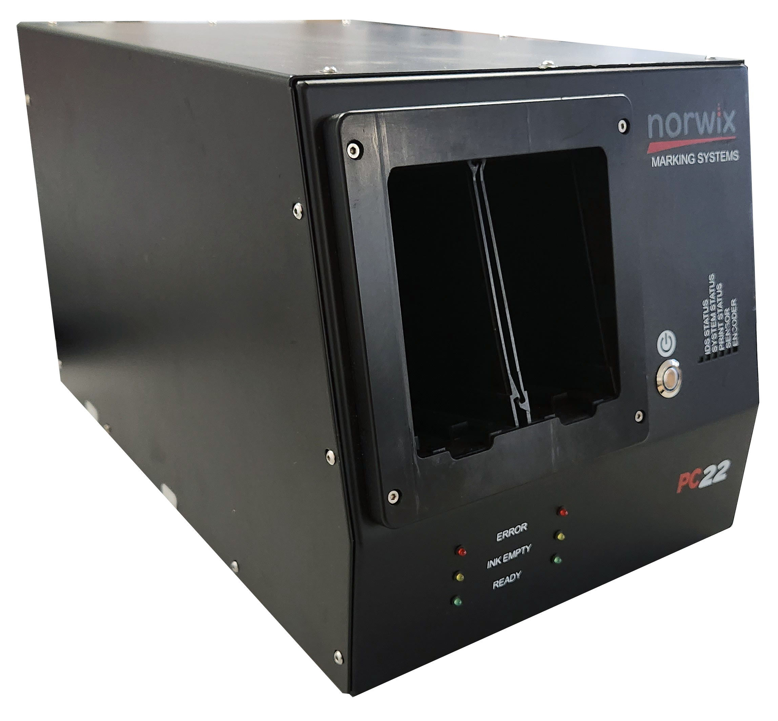
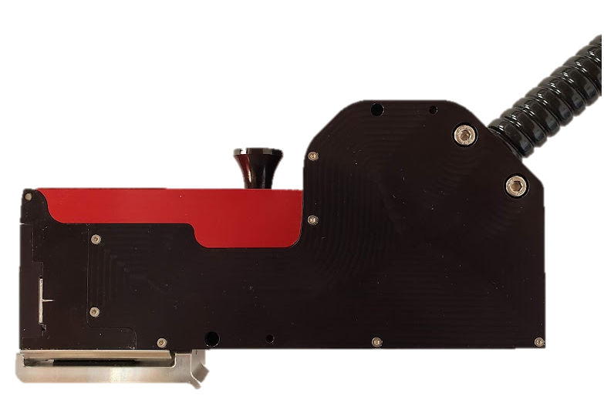
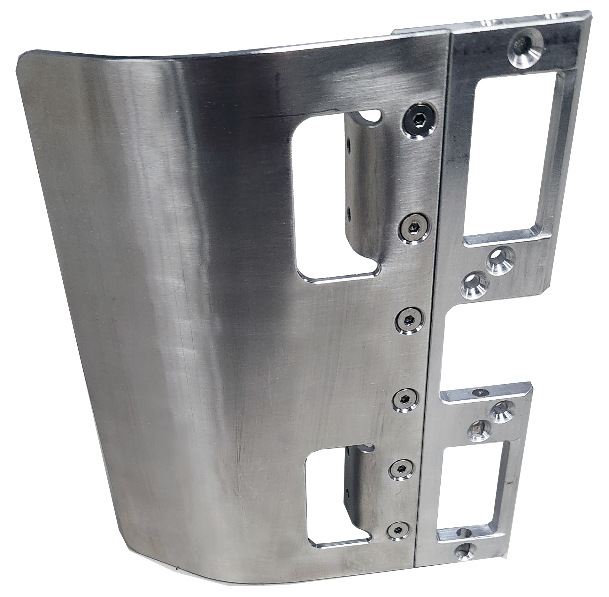
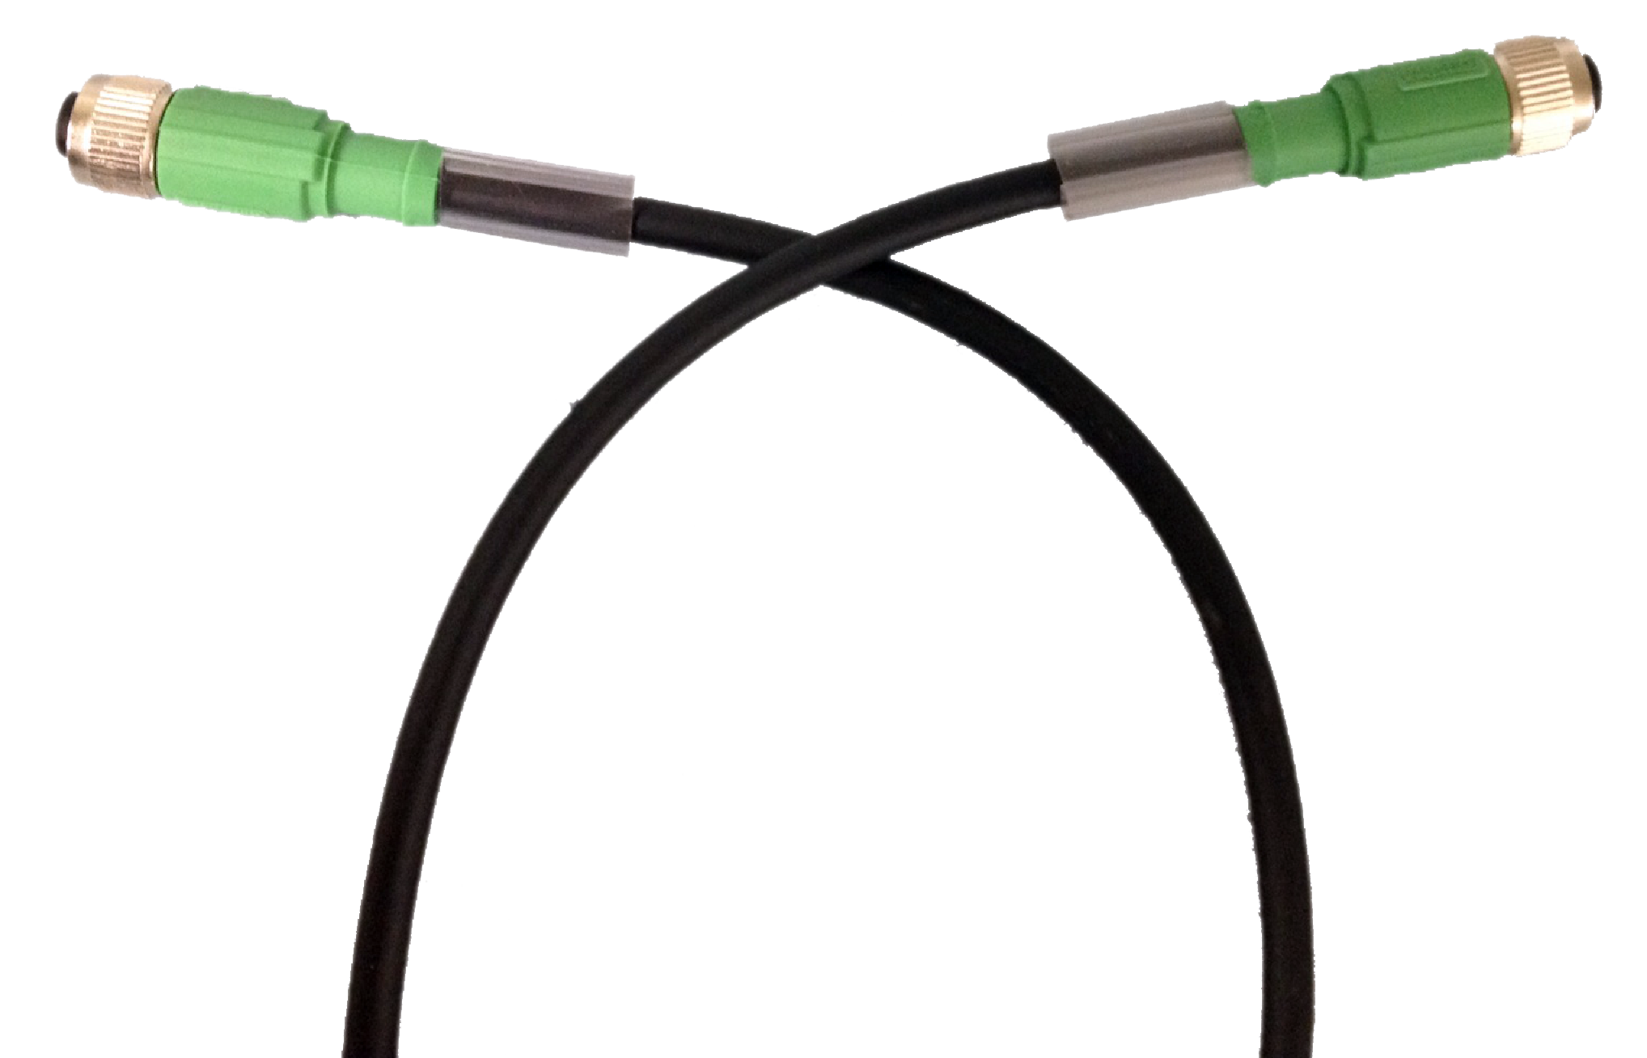
Encoder Kits
5019671G (Knurled Wheel)
5020082G (Urethane Wheel)
PC22 Catalog 2024
Laser Sensor Kit
5020159G
High-accuracy laser sensor
2m cable
Resolution of 1800 pulses/rev
2m cable length
6” circumference wheel
Stack Light
5019315G
Includes cable and mounting
Connection is via Stack Light Connector
I/O Cable Assembly
4971170G
Mini Sensor
4093075G
Connection to stack light connection on UNO Plus
5 m length
Custom lengths available
Label sensor
Needs additional Sensor Cable (4971005G)
15” User Interface
5019311G
Industrial Touchscreen PC
Windows OS
Preinstalled with Vega
VESA Mounts
1 to 4 heads
7” User Interface
5019835G
Industrial Touchscreen PC
Embedded Linux
Preinstalled with Vega
VESA Mounts
Daisy Chain Cable
4970905G-0300
3m Length
Connects to Daisy In/Daisy out on Print Controller
PC22 Head Mount
5020247G
Sensor Interface Cable
4971005G
Suitable for sensor other than Norwix supplied
Required for Label Sensor
2 m length
Infeed Ski Kit
5020270G
Mounts Print head
Allows for 90-degree mounting
Adjustable horizontal and vertical locking handles
PC22 Print Controller 5020224G
PC22 Print Stall 5020220G
Affixes directly to print head
Can be mounted left or right of the print head
Mounting points for Mini Sensor (4093075G)
4.25” print width
Ricoh Gen 5 Head
2-meter umbilical to connectivity box
22mm print width
2.8m Umbilical
Supports up to 4 Print Stalls

